Slide 1

U.S FOOD AND DRUG ADMINISTARTION
SQL DATA ANALYSIS AND VISULAIZATION IN POWERBI
BY NAVEEN KUMAR P

Slide 2

BUSINESS OBJECTIVE
The Primary objective is to analyze U.S. Food and Drug Administration and perform data analysis and visualization using SQL and PowerBI based on the project goals

Slide 3



DATA USED FOR ANALYSIS
I have used SQL files to create required database and tables for my project, after performing SQL Data Analysis I have connected MYSQL server through POWERBI to import data present in SQL for visualization

Slide 4
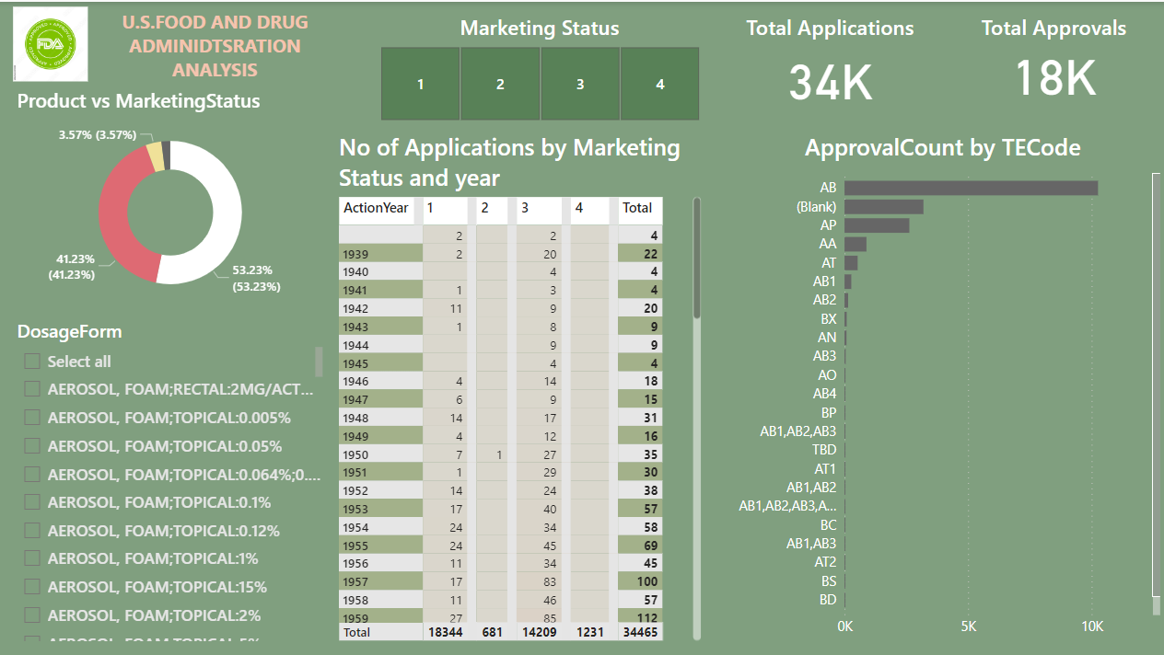
DASHBOARD REVIEW

Slide 5
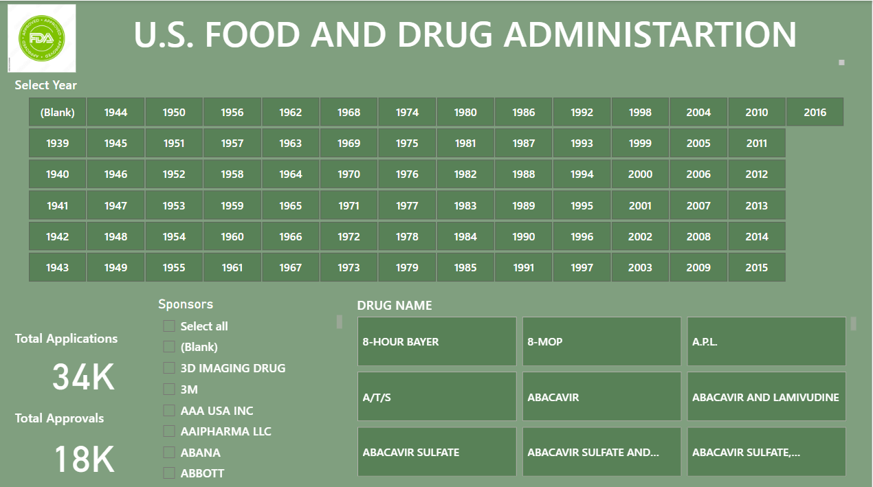

Slide 6
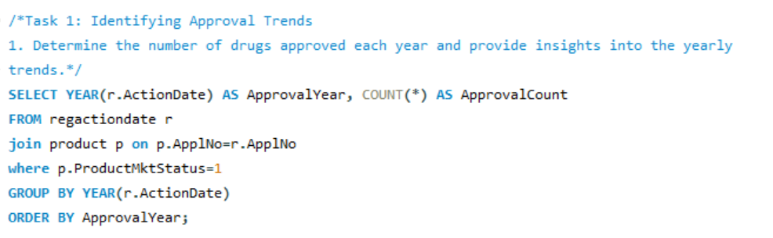
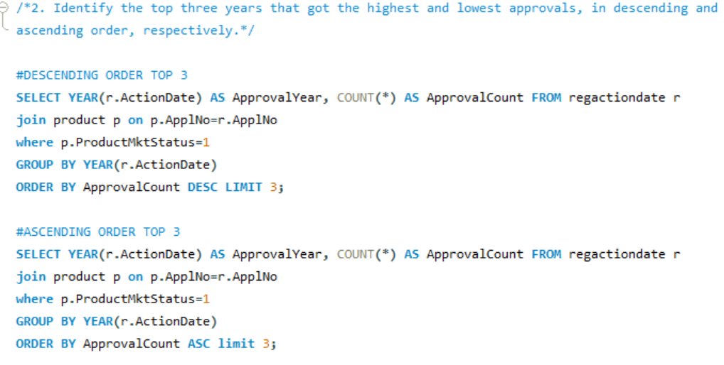
SQL PROJECT GOALS AND QUERIES

Slide 7
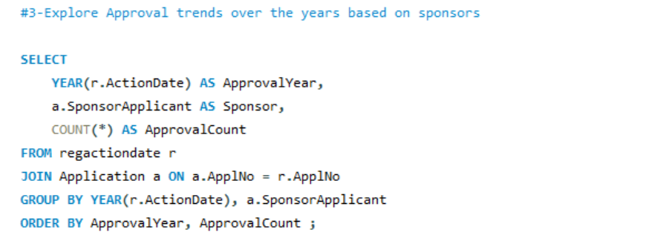
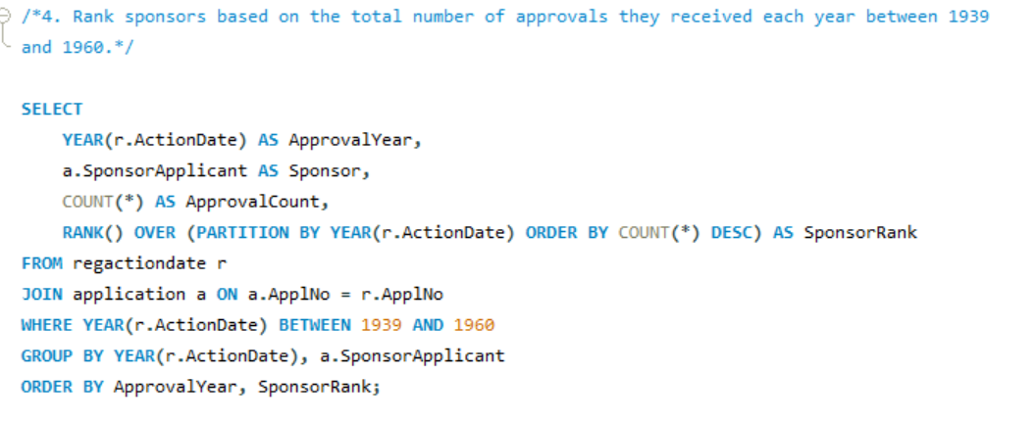

Slide 8
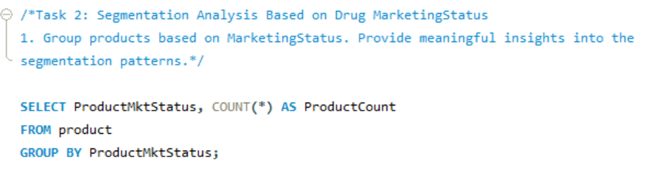
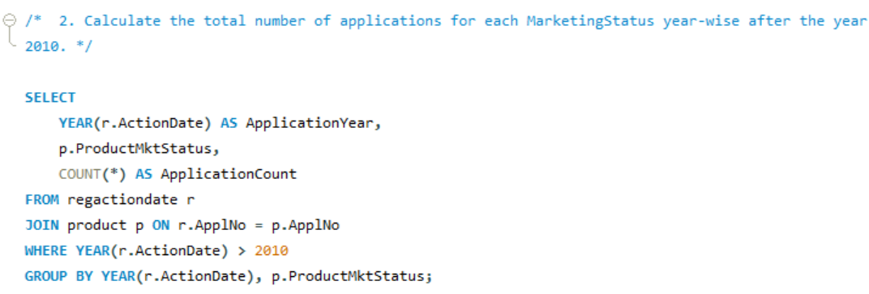

Slide 9
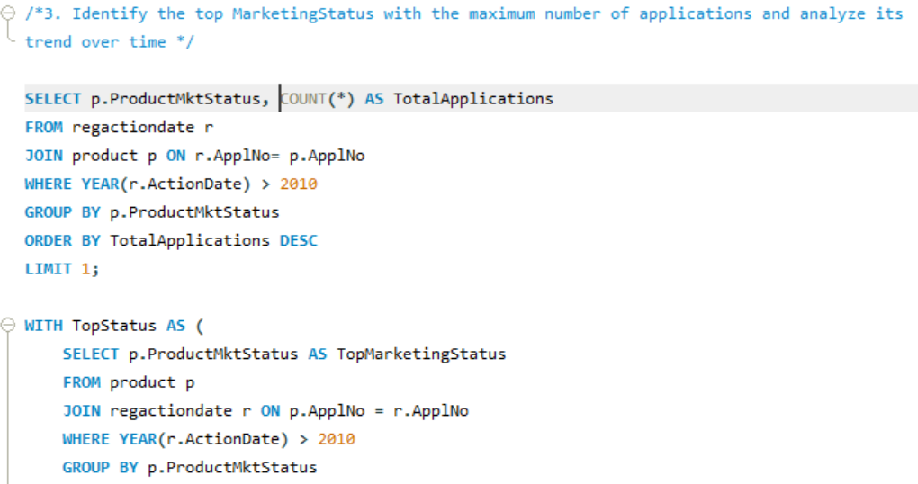
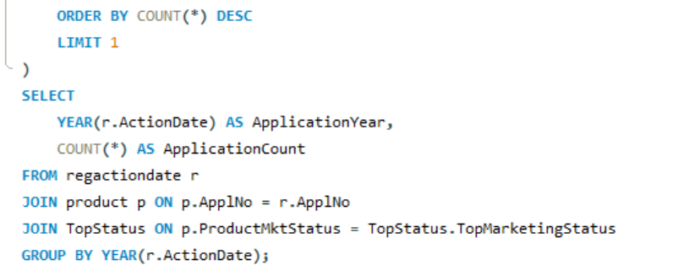

Slide 10
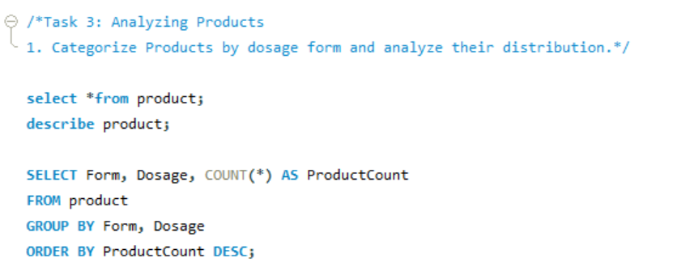
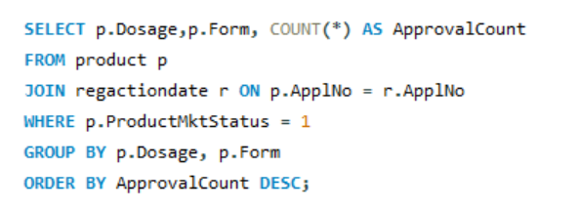

Slide 11
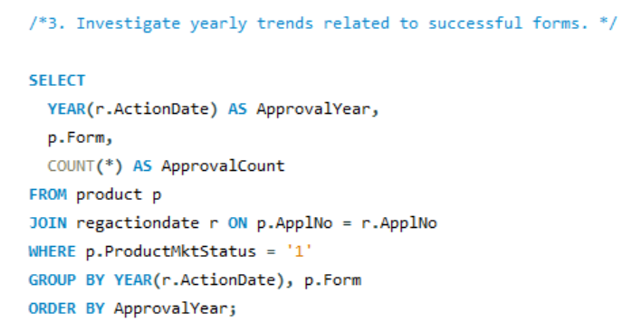
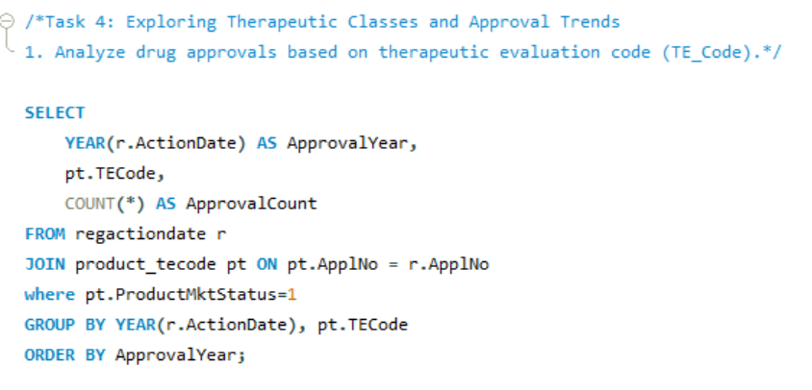

Slide 12
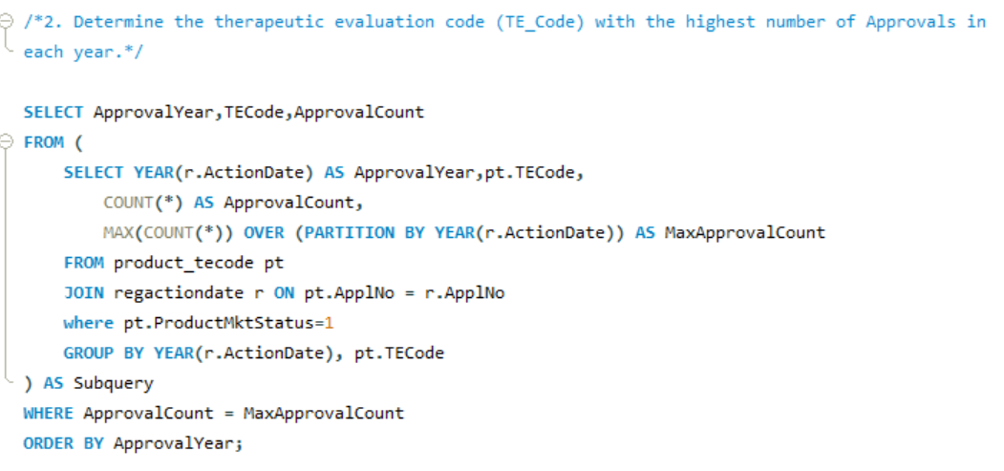

Slide 13

THANK YOU

